Slide 3




Paolo Pialorsi
PiaSys.com
Office 365 Developers Patterns and Practices Core Team
MCSM – Charter SharePoint & Office 365 MVP
http://www.piasys.com/
paolo@pialorsi.com
@PaoloPia

Slide 4
Remote Provisioning with the new PnP Provisioning Engine

Slide 5
What is OfficeDev PnP?

Slide 6

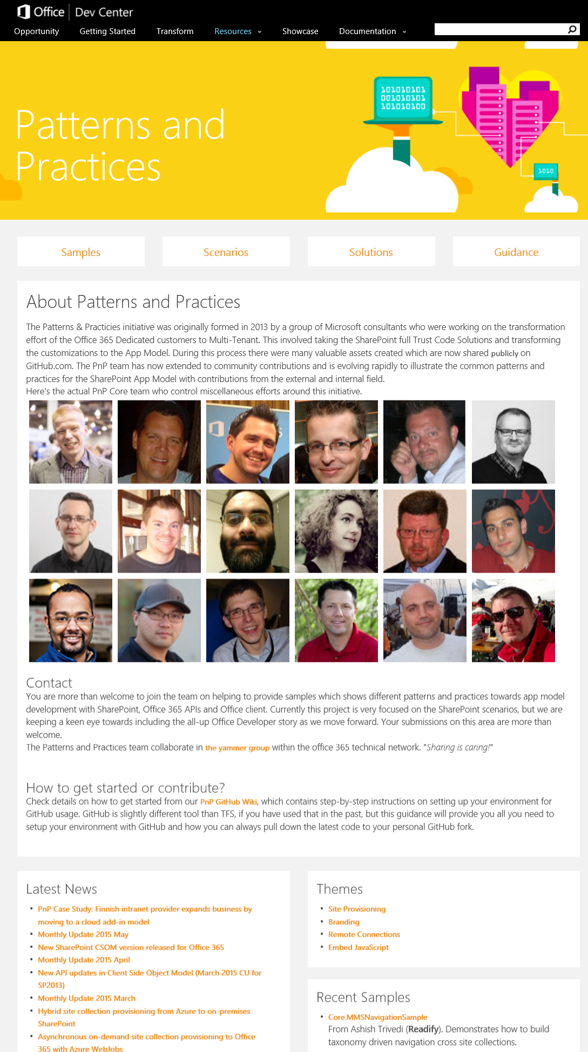
Developer
Patterns & Practices
aka.ms/OfficeDevPnP
aka.ms/OfficeDevPnPYammer
aka.ms/OfficeDevPnPMSDN
aka.ms/OfficeDevPnPVideos
aka.ms/OfficeDevPnPTraining

Slide 7
PnP Model
Reusable samples and solutions
Core component
Community
Training
Presentations
PnP
JDP program
Guidance / MSDN
Seminar materials
Videos
Other assets

Slide 8
Understanding Remote Provisioning

Slide 9
How to Provision Artifacts in SP/SPO?
“Once upon a time” there was the SharePoint Feature Framework
XML based provisioning of artifacts
CAML based syntax
We had Full Trust Code (FTC) WSP packages and Sandboxed Solutions
However FTC solutions work only on-premises
No way to have FTC in Microsoft Office 365
Sandboxed Solutions are partially deprecated
No more code-based Sandboxed Solutions
Feature Framework in general is painful
Issues about maintenance, control on results, versioning, etc.
Notes:
CAML = Collaborative Application Markup Language

Slide 10
Is there any suitable alternative?

Slide 11
Remote Provisioning
We can use code and programming to provision artifacts
Client Side Object Model (CSOM) is a good option
Main Benefits
Based on a remote pattern (REST/JSON) + Client Libraries
From anywhere (SharePoint Add-in, Timer Job, PowerShell, Console App, etc.)
Can be applied both on-premises and in SharePoint Online
Some Disadvantages
Developer-only, no UI/UX and not for business users
Sometime complex and/or verbose in its syntax
The maintenance can be still painful

Slide 12
Demo: Remote Provisioning with CSOM
Notes:
List Provisioning using CSOM only

Slide 13
PnP Remote Provisioning Engine

Slide 14
What is the PnP Provisioning Engine
Framework for easily doing Remote Provisioning
Part of the OfficeDev PnP Core Library
Object Oriented engine for easy and fast Remote Provisioning
Capabilities
Automated Remote Provisioning
Easy Site Template Generation/Extraction
Available in Microsoft .NET
There are PowerShell extensions for common tasks
Export/Import of templates in a formatter-independent manner
XML Schema – community defined
JSON
Whatever else …

Slide 15
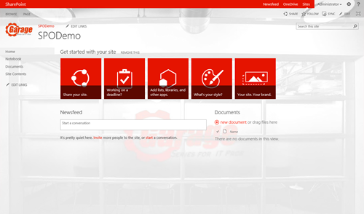
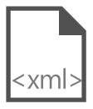
Site Provisioning Framework
C#
1
// Get template from existing site
template = ctx.Web.GetProvisioningTemplate();
Site A
XMLFileSystemTemplateProvider
2
// Save template using XML provider
XMLFileSystemTemplateProvider provider =
new XMLFileSystemTemplateProvider(@"c:\temp\", "");
string templateName = "template.xml";
provider.SaveAs(template, templateName);
// Load the saved model again
ProvisioningTemplate p2 =
provider.GetTemplate(templateName);
Connectors
XMLAzureStorageTemplateProvider
3
4
Site B
XMLSharePointTemplateProvider
// Apply template to existing site
ctxTarget.Web.ApplyProvisioningTemplate(template);

Slide 16
Demo: Playing with the PnP Provisioning Engine
Notes:
Hello World
Lookup
WebPart
Taxonomies

Slide 17
PnP Provisioning Engine Roadmap
What is on the roadmap (main goals)
On-premises support improvements
Delta templates
Document Set
Security
App Management
Publishing capabilities
Workflows
Full CSOM alignment (1:1)
It is a community project
Feel free to contribute with Issues, Pull Requests, Yammer threads

Slide 18
Transform your code Providing App Model Patterns for common Full Trust Code scenarios
130+ Visual Studio projects Common scenarios
Branding
Site provisioning
Remote event receivers
Large file support
Taxonomy driven navigation
And much more…
Contribute
This is open source project and open for contirbutions
Developer
Patterns & Practices
aka.ms/OfficeDevPnP

Slide 19
Q&A

Slide 20
Paolo Pialorsi
PiaSys.com
Office 365 Developers Patterns and Practices Core Team
MCSM – Charter SharePoint & Office 365 MVP
http://www.piasys.com/
paolo@pialorsi.com
@PaoloPia

